Slide 1

Topic 6 – Linear Classification and Regression Models
Statistics and Data Analysis
COR1-GB.1305
Prof: Chris Volinsky
NYU Stern: Spring 2024

Slide 2
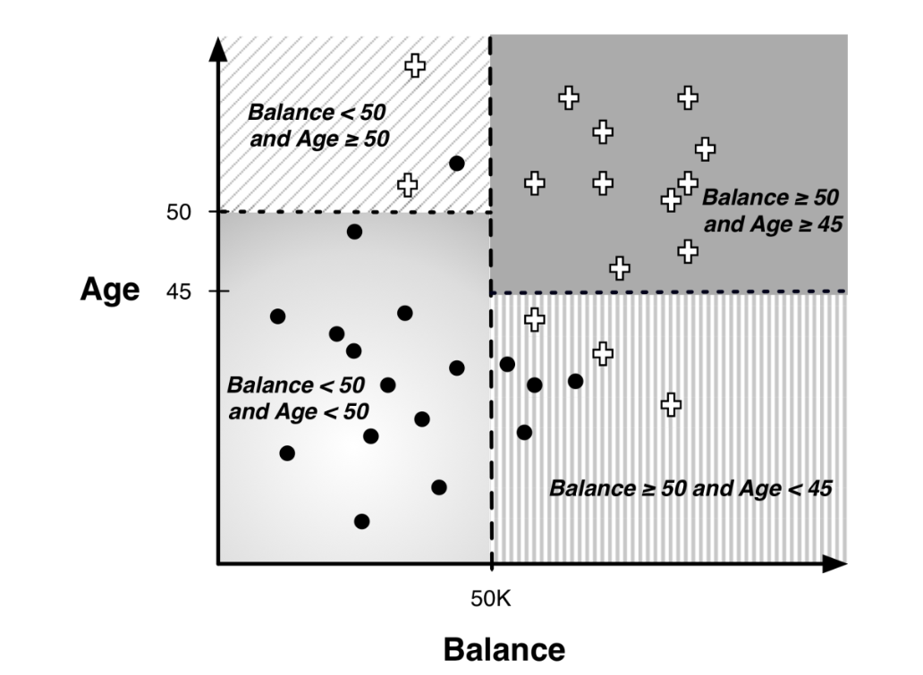
Mathematical Classification
Trees are a “rule-based” way to build classification models
Results in a partition of the input space
Uses rules that are parallel to axes:

Slide 3
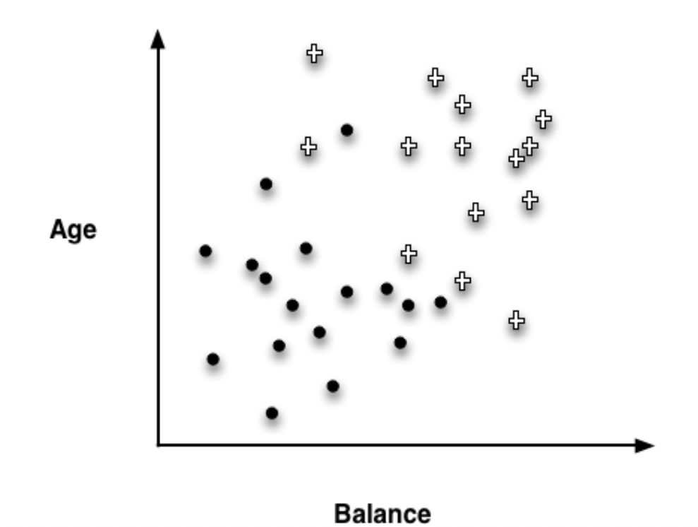
Mathematical Classification
Can you think of another way to separate these data?

Slide 4
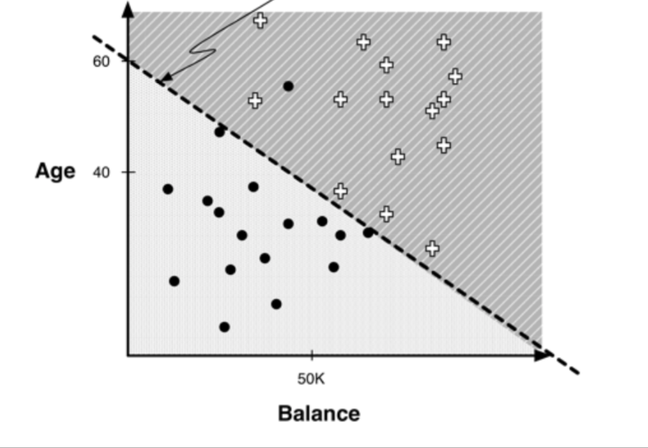
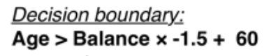
Linear Classification via Discriminants
Linear Discriminant model
“best” line is found via mathematical optimization
This is NOT regression!

Slide 5
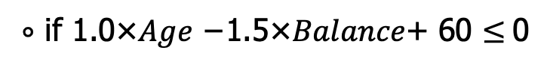
Linear Discriminant Models
Linear discriminant:
+ if 1.0×𝐴𝑔𝑒 −1.5×𝐵𝑎𝑙𝑎𝑛𝑐𝑒+ 60 > 0
Class(x) =
$∘$ if 1.0×𝐴𝑔𝑒 −1.5×𝐵𝑎𝑙𝑎𝑛𝑐𝑒+ 60 $≤$0
Linear discriminants:
Are a parameterized model: the weights of the linear function are the parameters determined by the algorithm
Creates a single mathematical function in all of the parameters to determine the class, rather than a disjointed collection of rules that trees do
This can be a pro or con for interpretability
Good when
You believe the relationship might be linear
You have smaller data sets
Complexity can be increased by incorporating quadratic or higher degree polynomials.
from sklearn.discriminant_analysis import LinearDiscriminantAnalysis

Slide 6
Support Vector Machines

Slide 7
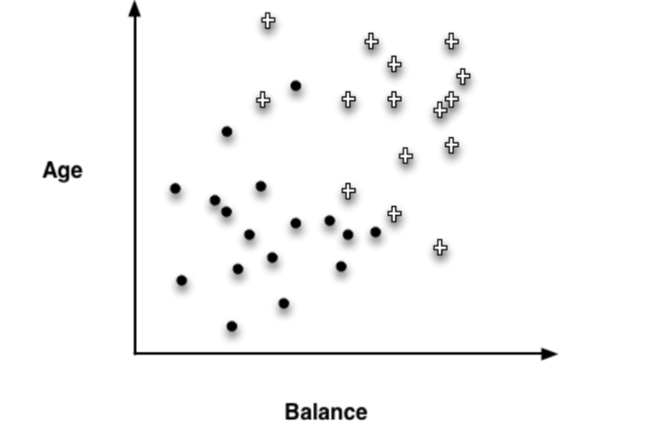
Classification via Support Vector Machines
Support Vector Machines are another type of mathematical model that finds linear boundaries between classes
They have become quite popular in recent years due to their superior performance in classification problems.

Slide 8
Which line is better?
Best line: Fewest errors!

Slide 9
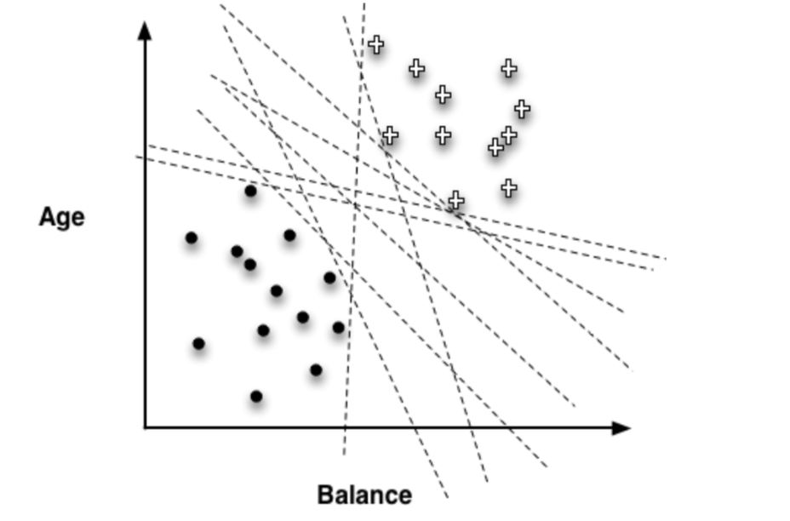
Which line is best?
Simplifying assumption: points are separable
Prefer the one with the most space in between?
How would you measure this?

Slide 10
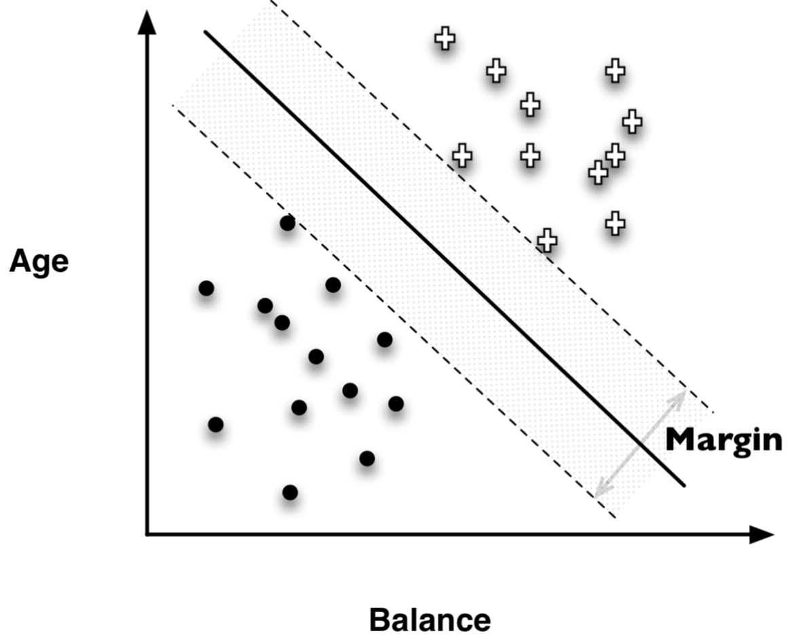
Maximizing margin: support vector machine (SVM)
The optimal SVM is the boundary that maximizes the margin
Of course data is not typically separable, but there are some clever mathematical tricks devised to deal with that
Computationally complex, but
from sklearn import svm
SVM has complexity parameters:
C : “the cost”: higher values fit training data more closely
Kernel: linear or non-linear + degree of polynomial
ISL: Chapter 9.3 – 9.6 has good explanation plus python code

Slide 11
Module5_ModelAssessment
Model_assessment.ipynb

Slide 12
Regression

Slide 13
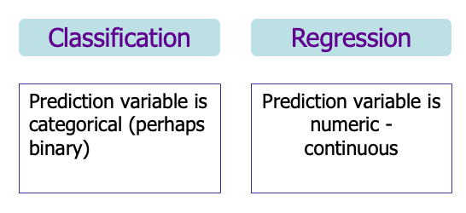
Regression models
Recall we categorize predictive models by the target
Decision Tree models are classification models
Now we focus on Regression models

Slide 14
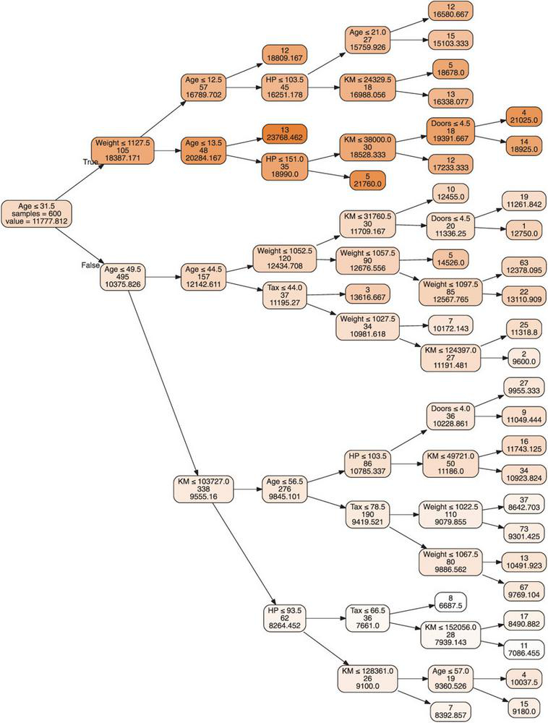
Regression Trees
Tree models can also be used with a numeric outcome, called Regression Trees
Purity is measured by the variance in the nodes
Prediction accuracy is measured by mean squared error or other metric
Fitting process is similar to Classification Trees
Example: Predicting the price of used Toyota Corollas
From sklearn.tree import DecisionTreeRegressor
Shmueli: Chapter 9.6

Slide 15
Regression Trees Example
Maybe do Shmueli example??

Slide 16
Module5_ModelAssessment
Model_assessment.ipynb

Slide 17
Linear Regression
Linear Regression is a mathematical optimization model to predict a numeric variable from one or multiple other variables
Can be numeric or categorical
Simple Linear Regression (SLR)
Only one explanatory variable (attributes)
Multiple Linear Regression (MLR)
Multiple explanatory variables (attributes)
Statistics: Focus is on parameter estimates, interpretations and significance
Data Science: Focus is on using the model for prediction
- assumptions for linearity, normality, etc, not as important
from sklearn.linear_model import LinearRegression
import statsmodels.formula.api as sm

Slide 18
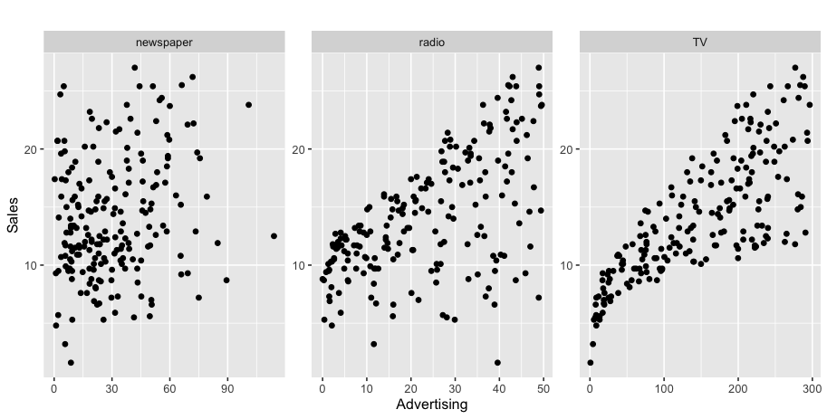
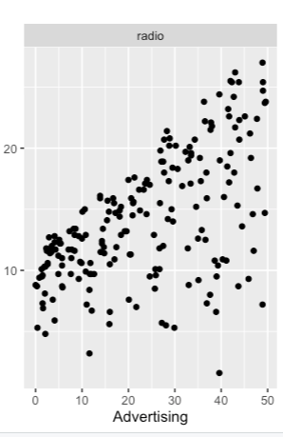
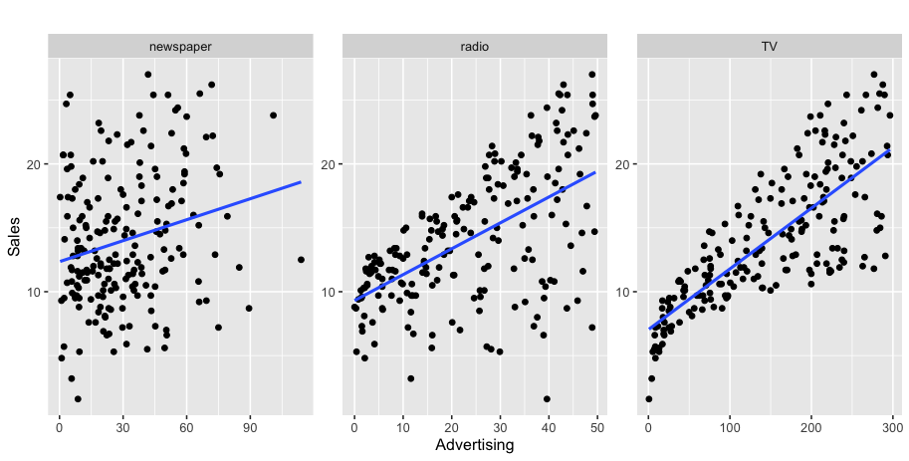
Regression Example – Advertising v Sales
sales
Is there a relationship between advertising and sales?
How strong is the relationship between advertising and sales?
How accurately can we predict future sales?
Is the relationship linear
Which media are associated with sales?
Which media has the strongest connection to sales
Is there synergy among the advertising media
Notes:
Advertising in different markets

Slide 19
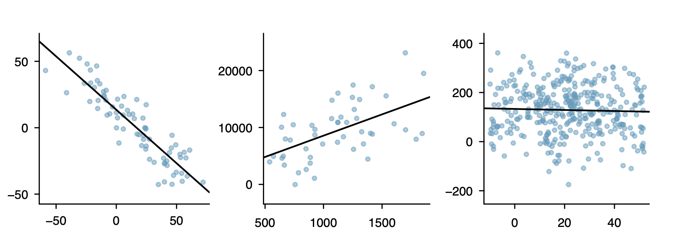
Linear Relationships
Recall our correlation coefficient r_{xy} :
Between -1 and 1
Measures linear relationship between X and Y
Closer r_{xy} is to 1 or -1 the stronger the linear relationship
Can be positive (up) or negative (down)
Close to 0 means no relationship
Linear models are useful!
Data relationships are often (at least approximately) linear
r_{xy} measures how well the data fall along a given line
Regression tells us what the line is in mathematical form
Even though data does not fall exactly on the line, it gives us the trend, and allows us to make estimations.

Slide 20
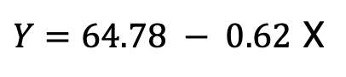
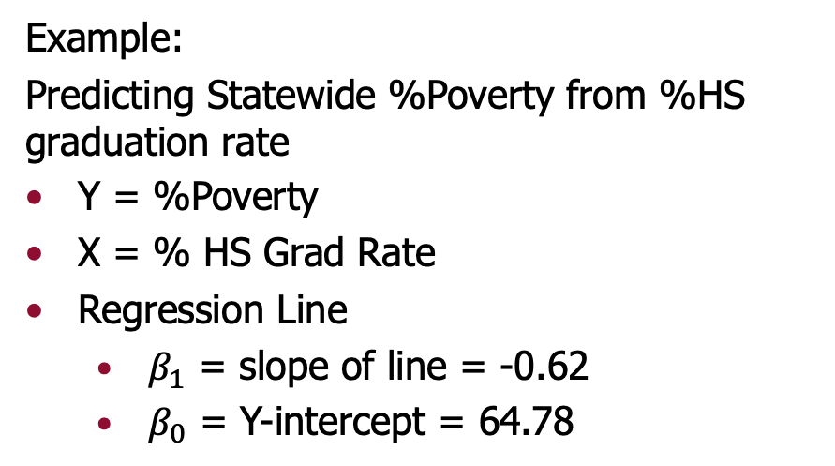
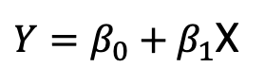
Defining the Regression Line
Any line is mathematically expressed as an equation with a slope and an intercept (you may have seen y=mx+b in algebra)
Regression Line Equation:
$Y=β_{0}+β_{1}$X
Example:
Predicting Statewide %Poverty from %HS graduation rate
Y = %Poverty
X = % HS Grad Rate
Regression Line
$β_{1}$ = slope of line = -0.62
$β_{0}$ = Y-intercept = 64.78
$Y=64.78 − 0.62$ X
negative slope= negative relationship =negative correlation

Slide 21
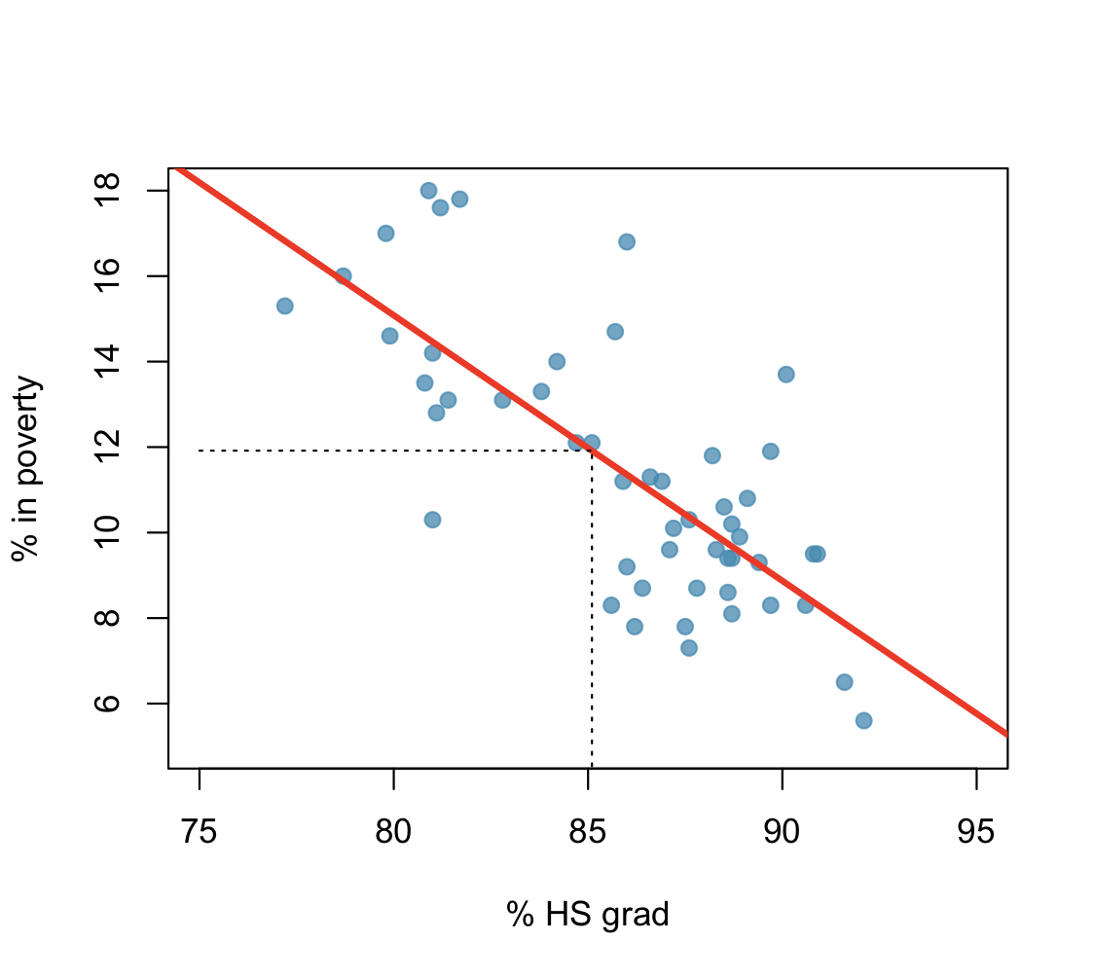
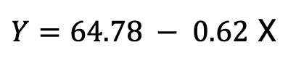
Regression line
$Y=64.78 − 0.62$ X
The high school graduation rate in Georgia is 85.1%. What poverty level does the model predict for this state?

Slide 22
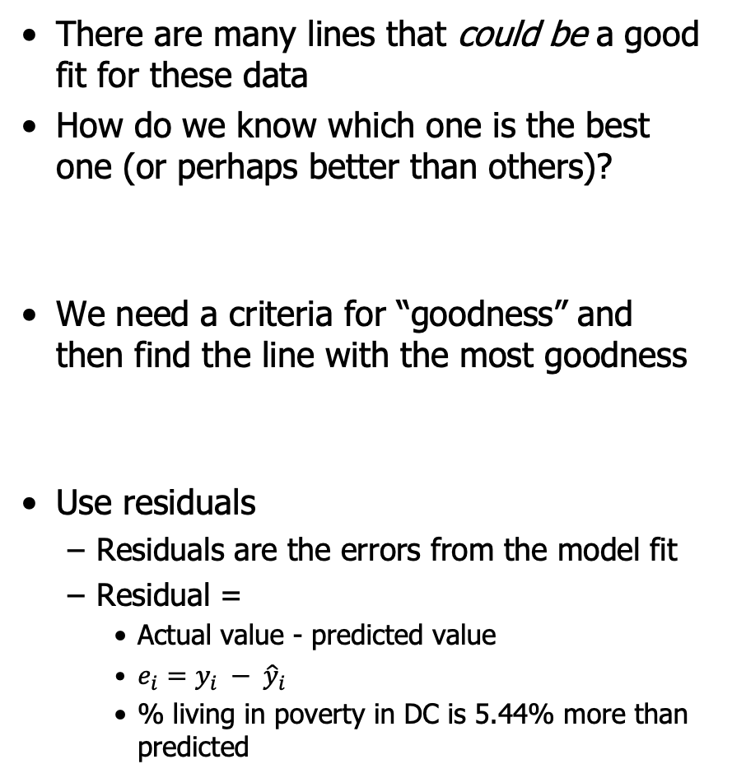
Finding the Right Regression Line
There are many lines that could be a good fit for these data
How do we know which one is the best one (or perhaps better than others)?
We need a criteria for “goodness” and then find the line with the most goodness
Use residuals
Residuals are the errors from the model fit
Residual =
Actual value - predicted value
$e_{i}=y_{i} − {\hat{y}}_{i}$
% living in poverty in DC is 5.44% more than predicted

Slide 23
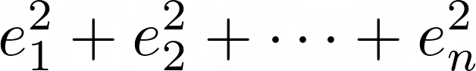
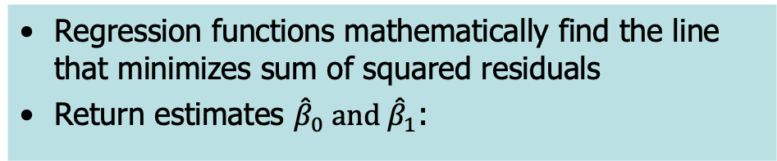
Least Squares Regression Line
The least squares regression line is the line that minimizes the sum of the squared residuals
Squares? This makes sure errors don’t cancel out
Try it! : Regression By Eye
https://www.statcrunch.com/applets/type2&regbyeye
Regression functions mathematically find the line that minimizes sum of squared residuals
Return estimates ${\hat{β}}_{0} and{ \hat{β}}_{1}$:

Slide 24
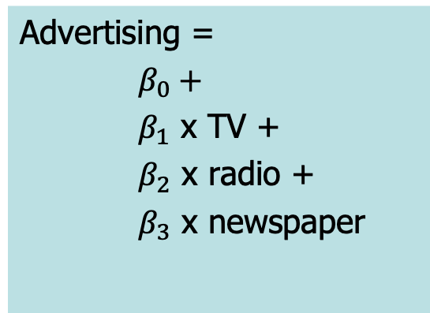
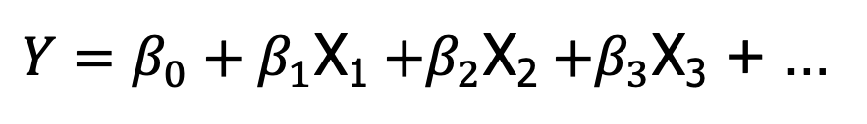
Regression Model
Our regression line equation defines the relationship between the random varialbles:
$Y=β_{0}+β_{1}$X₁ $+β_{2}$X₂ $+β_{3}$X₃ + …
Advertising =
$β_{0}+$
$β_{1}$ x TV +
$β_{2}$ x radio +
$β_{3}$ x newspaper

Slide 25
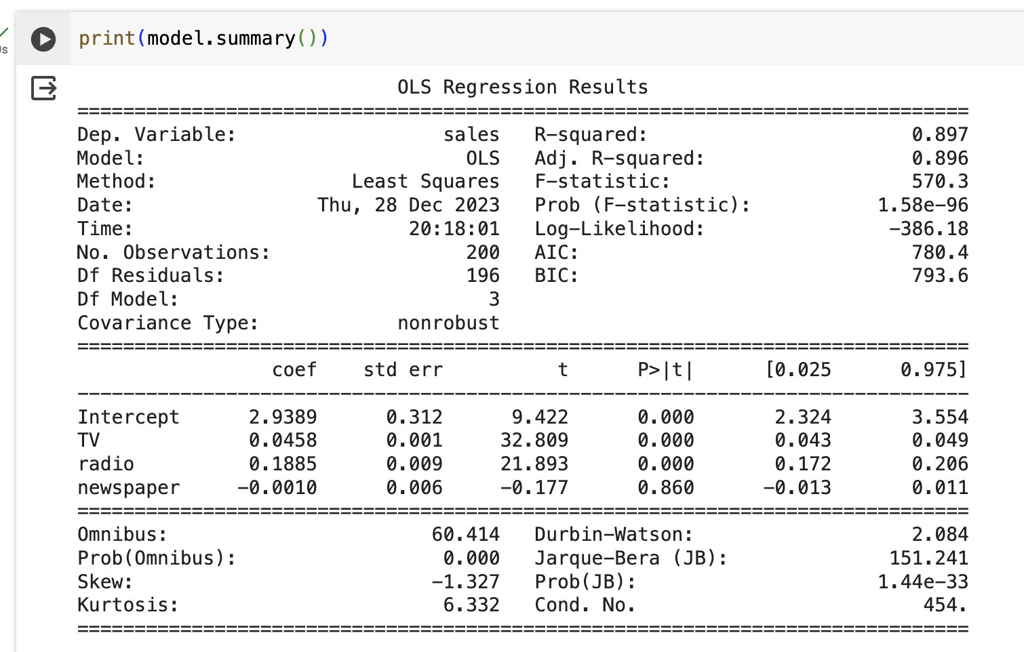
Regression output - python
Using statmodels

Slide 26
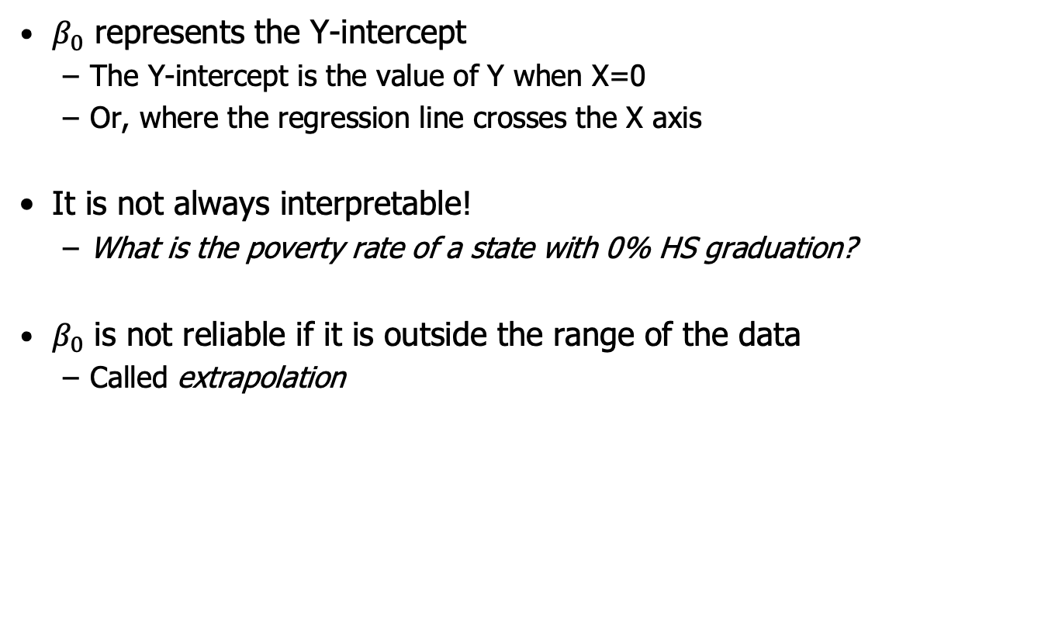
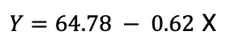

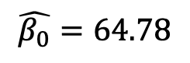
Interpretation of $β_{0}$
$Y=64.78 − 0.62$ X
$β_{0}$ represents the Y-intercept
The Y-intercept is the value of Y when X=0
Or, where the regression line crosses the X axis
It is not always interpretable!
What is the poverty rate of a state with 0% HS graduation?
$β_{0}$ is not reliable if it is outside the range of the data
Called extrapolation
$$\hat{β_{0}}=64.78$$

Slide 27

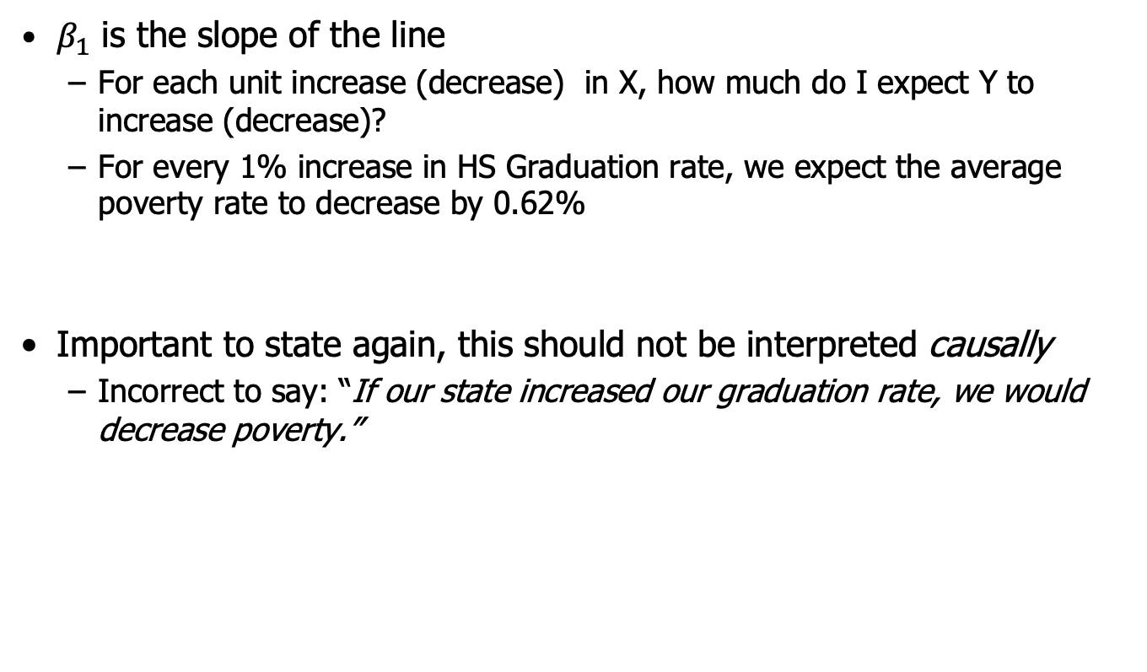
Interpretation of $β_{1}$
$Y=64.78 − 0.62$ X
$β_{1}$ is the slope of the line
For each unit increase (decrease) in X, how much do I expect Y to increase (decrease)?
For every 1% increase in HS Graduation rate, we expect the average poverty rate to decrease by 0.62%
Important to state again, this should not be interpreted causally
Incorrect to say: “If our state increased our graduation rate, we would decrease poverty.”

Slide 28
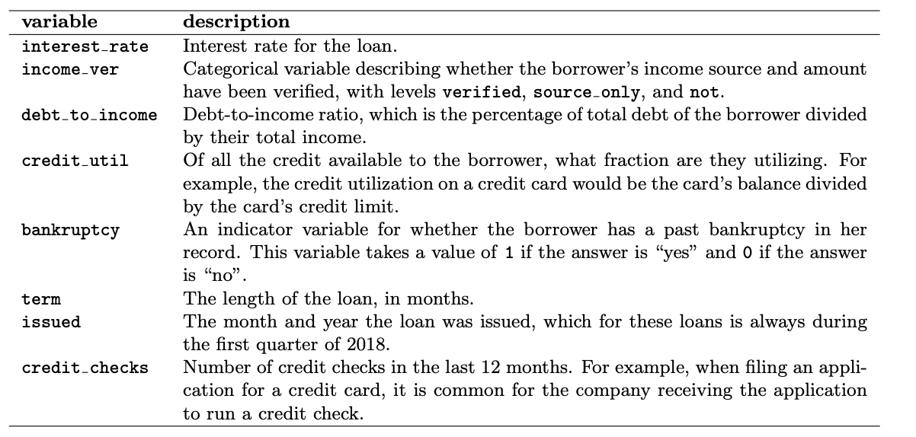
Including Categorical Variables in Regression
Recall: Categorical variables get recoded as binary indicator variables
New example: loans dataset in R (openintro)
Results regarding loans from a peer-to-peer lender, Lending Club, which connects online borrowers and lenders
Loan data has terms of the loan as well as info about the borrower.
They set the interest rate, but little is known about how they do it.
Openintro
Chapter 9.1

Slide 29
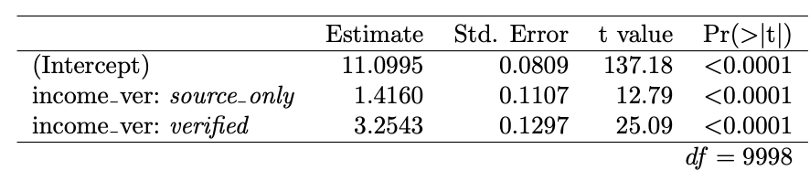
Lending Club: Categorical Predictors
With categorical variables, binary or multi-level – you must set a baseline level that other levels will be compared to:
One such variable is Income_ver which reflects wither the borrowers income source and amount have been verified
It has 3 levels (not verified, source_only, verified)
We use “not verified” as the baseline and create two indicator variables
Not verified, is like setting both indicators to zeros
fit the regression for this variable
Each value of the variable levels has a fit against the baseline “not verified”
Interpret the regression equation:
What is the predicted interest rate for the three types of income verification (none, source_only, verified)?

Slide 30
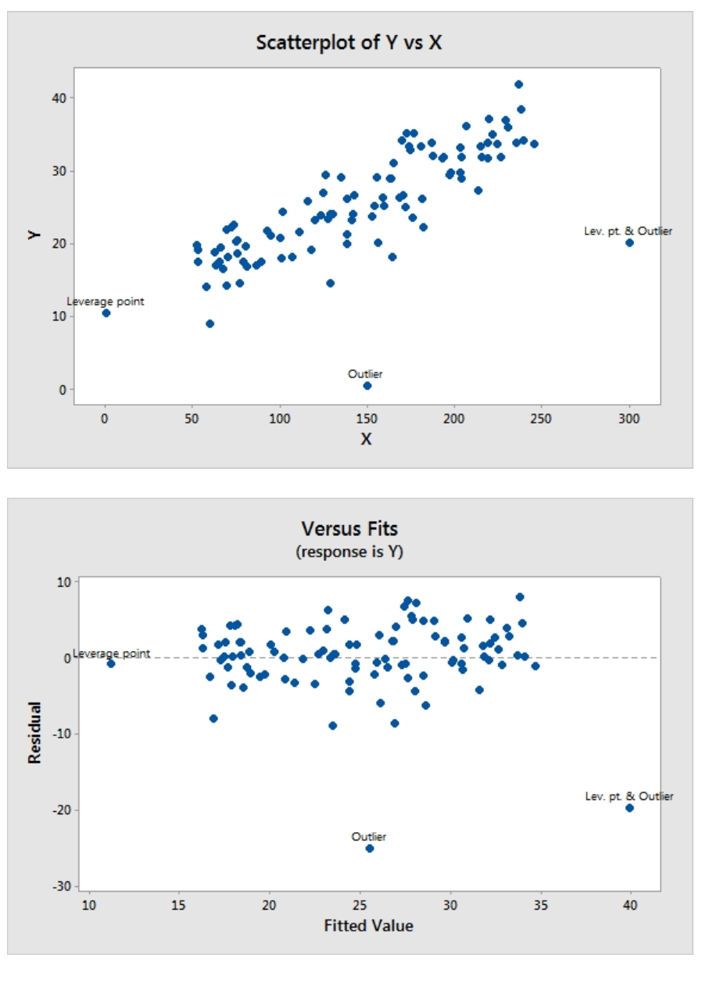
Regression Concerns
Regression is very popular due to its nice mathematical properties and clear interpretations, BUT
Watch out for violations of key assumptions:
Linear relationship
Normality of residuals
Constant variance
Violation of these will hurt performance of regression
Regression can be sensitive to
Outliers
leverage points
Highly correlated predictors

Slide 31
Extending Regression Models

Slide 32

Logistic Regression
Logistic Regression is a bit of a misnomer
It is actually a technique for Classification
Typically with a binary response
But: it uses a clever transformation of the binary response so it can use the same techniques as linear regression
Logistic regression is typically used for “Class Probability Estimation”
from sklearn.linear_model import LogisticRegression

Slide 33
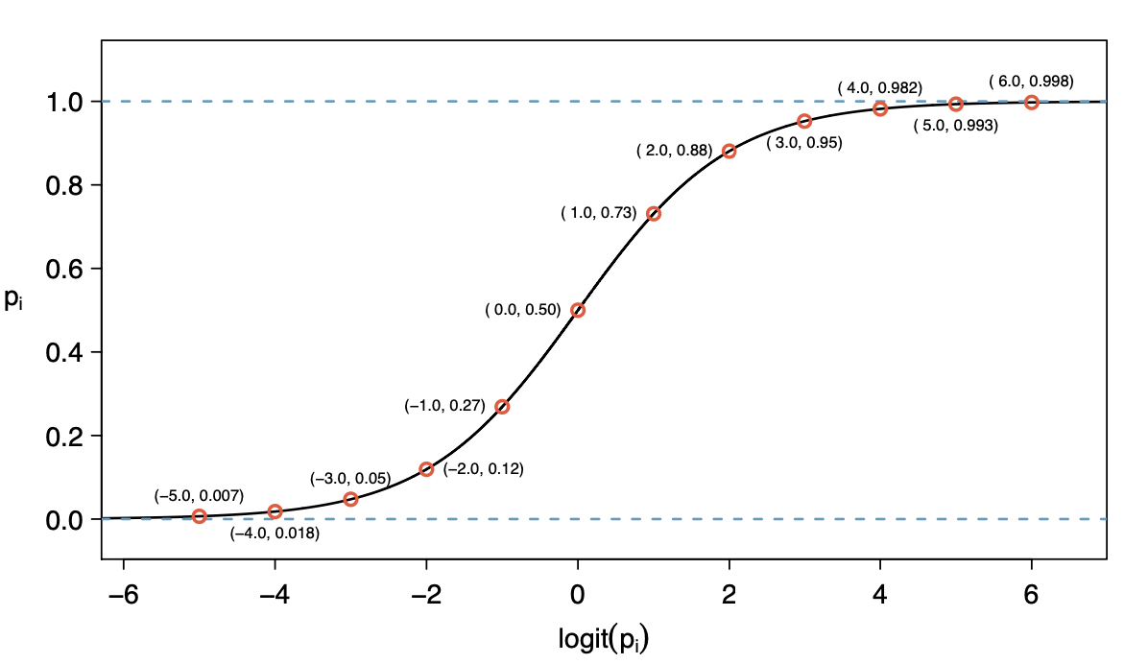
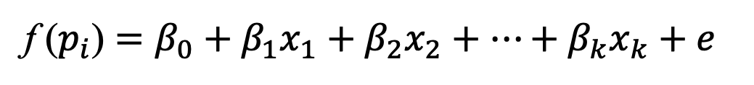
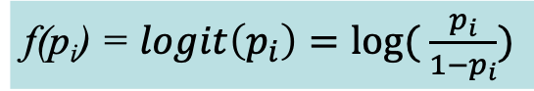
Logistic Regression
Instead of trying to predict the binary target directly, Logistic Regression directly predicts the probability of a “success” (or whatever the value of 1 represents)
Model:
f ($p_{i}$) $=β_{0}+β_{1}x_{1}+β_{2}x_{2}+⋯+β_{k}x_{k}+e$
f(p_{i}) = $logit\left(p_{i}\right)=log⁡( \frac{p_{i}}{1−p_{i}})$
Logistic loss =

Slide 34
Loss Functions
Linear regression, logistic regression, and support vector machines are all very similar instances of a basic fundamental technique:
Using mathematical optimization to fit a function
The difference is in the objective function or loss function that is minimized to find the parameters of the function
Method | Type of Problem | Loss Function
Linear Regression | Regression | Squared-error loss
Logistic Regression | Classification | Logistic loss
Support Vector Machines | Classification | Hinge loss
Many many different loss functions!

Slide 35
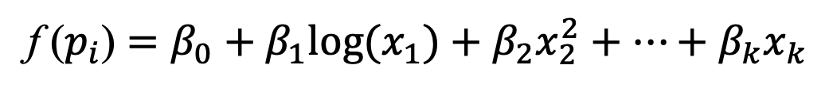
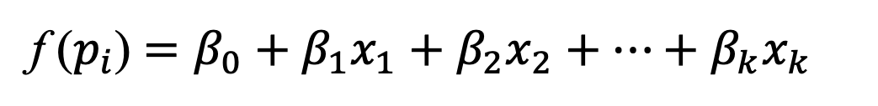
Non-linear regression models
Both linear regression and logistic regression are linear in the features
f ($p_{i}$) $=β_{0}+β_{1}x_{1}+β_{2}x_{2}+⋯+β_{k}x_{k}$
Linear models are convenient, and easy to interpret, but sometimes it makes sense to explore non-linear relationships
One “trick” to do this, is to keep a linear model, but transform the predictor:
Logarithmic
Square or other polynomial
f ($p_{i}$) $=β_{0}+β_{1}{log(x}_{1})+β_{2}x_{2}^{2}+⋯+β_{k}x_{k}$
We get the benefits of regression but allow for non-linearities in the fit…

Slide 36
Complexity and Overfitting in Regression

Slide 37
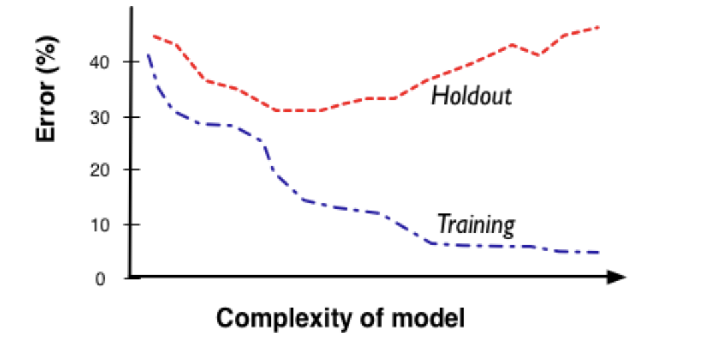
Complexity
Remember the complexity conundrum
More complexity allows us more freedom and flexibility to fit the messy realities
BUT higher complexity runs the risk of overfitting data

Slide 38


Complexity in Regression
For regression models, complexity comes in multiple forms – often called the “dimensionality” of the model
Number of attributes
More attributes means more complex relationships
Categorical variables can explode dimensionality (remember one-hot encoding)
Functional form of the regression
Degree of polynomial
In general we want to follow “Occam’s Razor”
Keep the model as simple as possible while maintaining predictive performance
Adding attributes might make our model better!
But now we’ve added complexity and might be overfitting

Slide 39
Complexity in Regression
There are real-world scenarios where we may want to explore hundreds, thousands, even MILLIONS of attributes
Recommender Systems
Web-based marketing models
Financial models with time based attributes

Slide 40
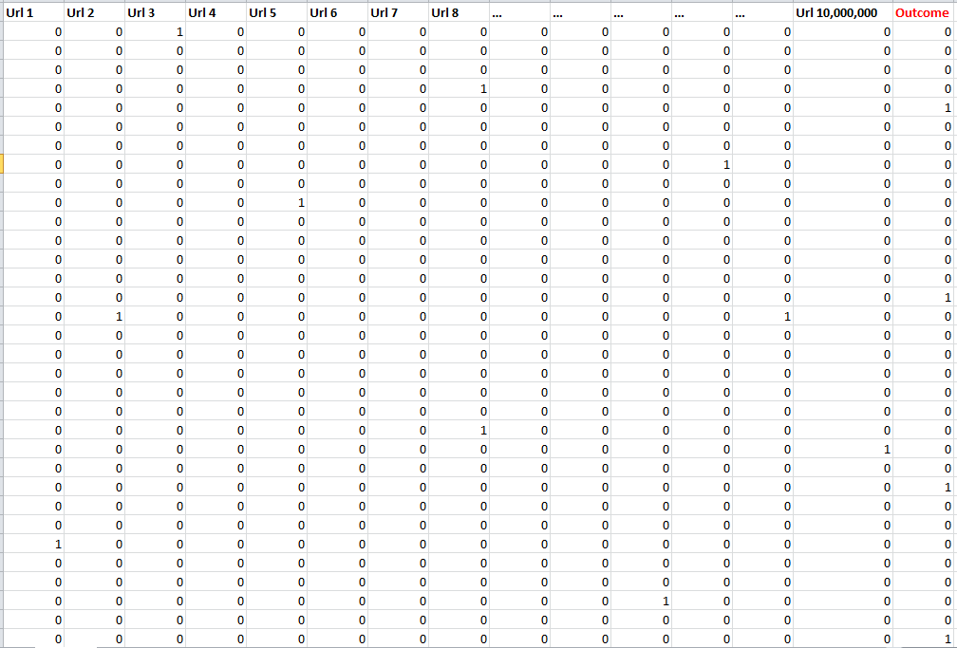
A real example….
10 Million Columns
1-50K Positives

Slide 41
Complexity in Regression
Two ways to reduce complexity when you have a HUGE number of attributes
Reduce the number of attributes!
Can use variable selection to reduce the number of attributes
2) Use a penalty in the objective function
Called regularization
One simple trick to address complexity…

Slide 42

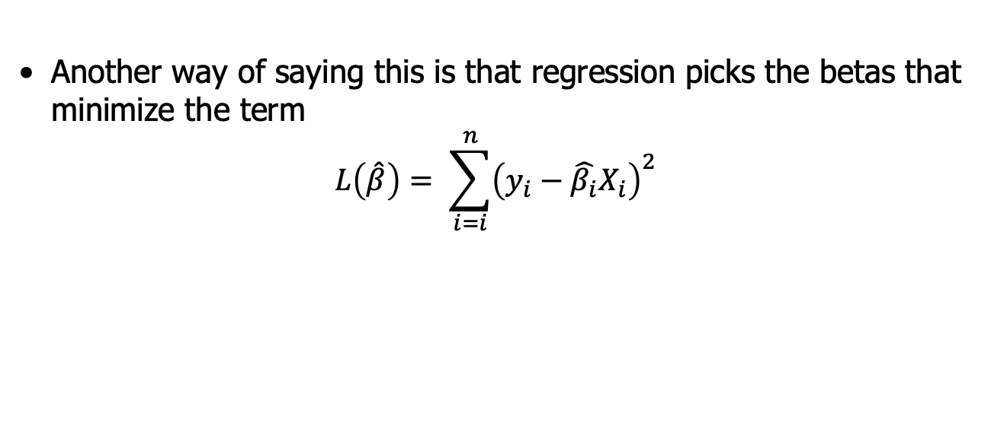
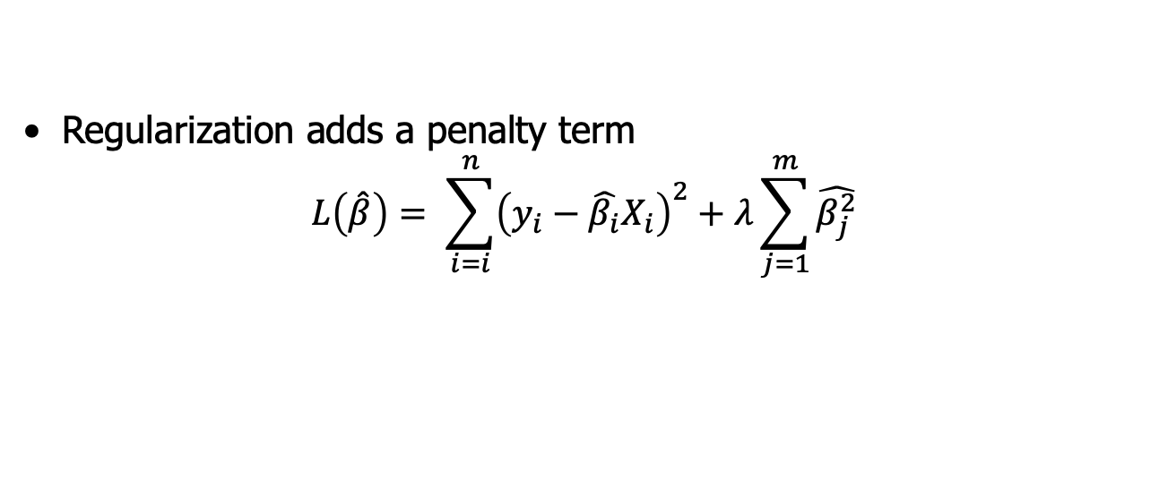
Regularized Regression
Recall how we find the best regression line
The least squares regression line is the line that minimizes the sum of the squared residuals
Another way of saying this is that regression picks the betas that minimize the term
$$L\left(\hat{β}\right)= \sum_{i=i}^{n}{{\left(y_{i}−\hat{β_{i}}X_{i}\right)}^{2}}$$
Regularization adds a penalty term
$$L\left(\hat{β}\right)= \sum_{i=i}^{n}{{\left(y_{i}−\hat{β_{i}}X_{i}\right)}^{2}+λ\sum_{j=1}^{m}{\hat{β_{j}^{2}}}}$$

Slide 43
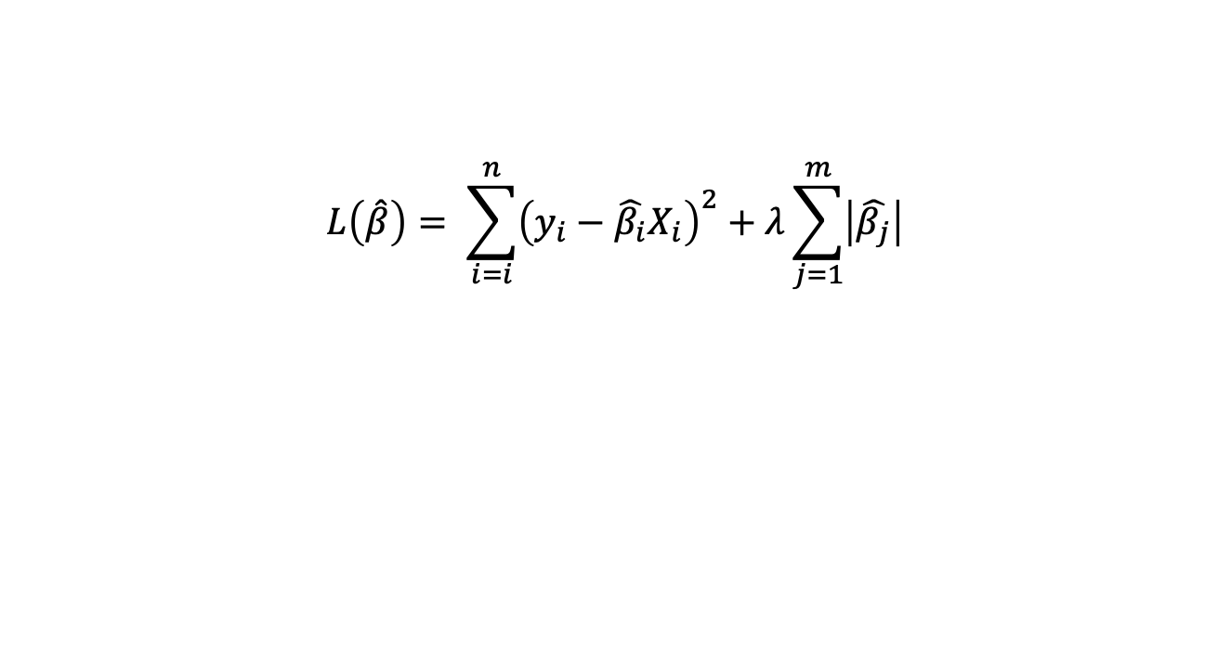
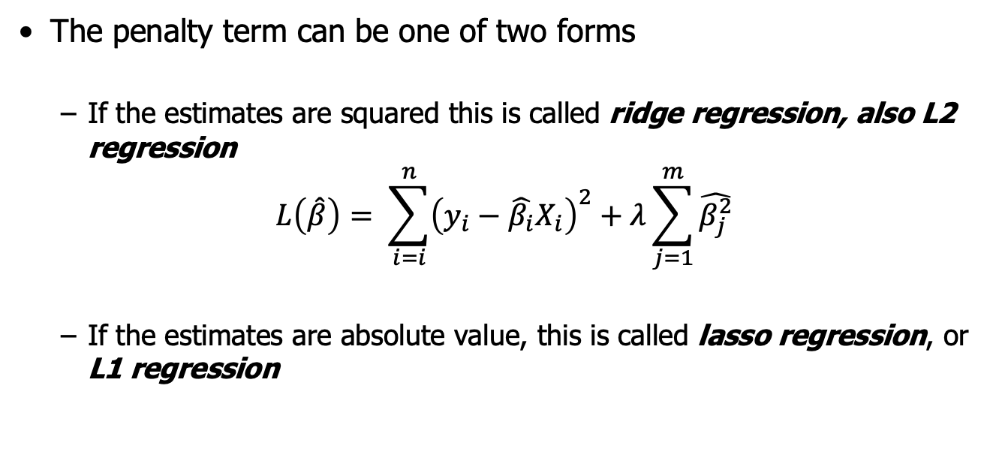
Regularized Regression
The penalty term can be one of two forms
If the estimates are squared this is called ridge regression, also L2 regression
$$L\left(\hat{β}\right)= \sum_{i=i}^{n}{{\left(y_{i}−\hat{β_{i}}X_{i}\right)}^{2}+λ\sum_{j=1}^{m}{\hat{β_{j}^{2}}}}$$
If the estimates are absolute value, this is called lasso regression, or L1 regression
“ridge penalty”
$$L\left(\hat{β}\right)= \sum_{i=i}^{n}{{\left(y_{i}−\hat{β_{i}}X_{i}\right)}^{2}+λ\sum_{j=1}^{m}{\left|\hat{β_{j}}\right|}}$$
“lasso penalty”
The penalty parameter (λ) protects us against overfitting
The typical result of the penalty is to “shrink” the β parameters
Regularization is also often referred to as shrinkage

Slide 44

Key points about Regularized Regression
Regularized regression can be used when you have many attributes and don’t have a good way of reducing the total amount
Two types of regularization:
Ridge: uses squared penalty (L2)
Lasso: uses absolute penalty (L1)
Single parameter (λ) determines the amount of regularization
λ = 0 means no regularization
Larger λ is stronger penalty
λ can be determined by cross-validation
sklearn.linear_model.Lasso
sklearn.linear_model.Ridge

Slide 45
Lasso Regression
One final fun fact about lasso regression
We mentioned that the lasso will “shrink” parameter estimates towards zero
In the lasso case, it will force some of the coefficients to equal exactly zero
This ends up having the same effect as variable selection!
Lasso is very popular and tends to be very effective
More details: ISL Chapter 6.2

Slide 46
Module 4 : Regularization
Regularization_and_Learning_Curves.ipynb

Slide 47
Intro: Neural Networks

Slide 48
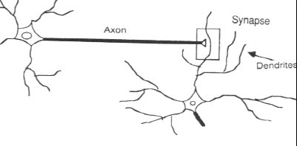
Inspiration from Biology
Analytic technique inspired by biological nervous systems
Structure of the
nervous system:
A large number of neurons (information processing units) connected together
A neuron’s response depends on the states of other neurons it is connected to and to the ‘strength’ of those connections.
The ‘strengths’ are learned based on experience.

Slide 49
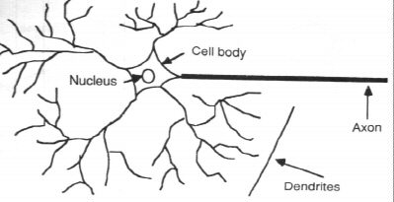
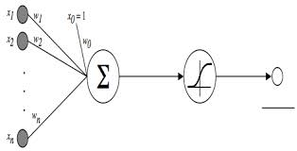
From Real to Artificial
data
Predicted probabilities
data
prediction
data

Slide 50
Nodes: A Closer Look
x₁
w₁
bias
Input
values
x₂
w₂
function
output
y
Perceptron:
A fairly simple model similar to logistic regression
x_{m}
w_{m}
weights

Slide 51
Neural Network: Architecture
Input
layer
Output
layer
Hidden Layer(s)
Big idea: several simple models working together to model a complex function
How many layers? Nodes? What is the function?
Multi-layer perceptron
from sklearn.neural_network import MLPClassifier

Slide 52

Neural Networks: The Model
Lots of decisions to make / optimize with neural nets
Architecture
Number of hidden layers
Number of nodes in the input, output and hidden layers
Specification of the activation function(s)
The associated set of weights
This is often an art, not a science!
Weights and complexity can be “learned” from the data
But lots of decisions need to be made also
Often criticized as “black box” models

Slide 53
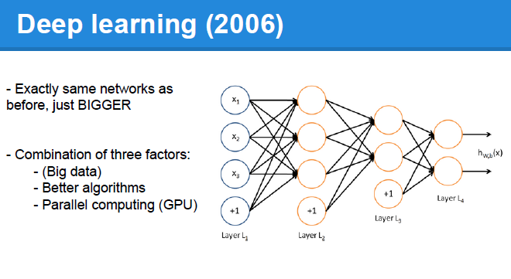
Taking Neural Nets to 11…
We will discuss deep learning more later, but it is probably beyond the scope of your projects

Slide 54
Summary

Slide 55
But which one should I use?
If world free of constraints, then (e.g. a data science competition):
Try them all, choose best performer
Else:
Consider all constraints on your problem.
Choose best performer subject to constraints

Slide 56

What model do I choose?
Classification v. Regression
Complexity of relationships
Are linear assumptions realistic?
Size of data
Neural nets need more data to train
Smaller sets = simpler models
Use of data
Do I need to run models in real time
Updating?
Feature engineering and data cleaning
Often more important than the model!
Interpretability vs. accuracy
Do you need to explain to someone?
How important is the best model?
The Data Science Way: Try them all, choose the best performer!!

Slide 57
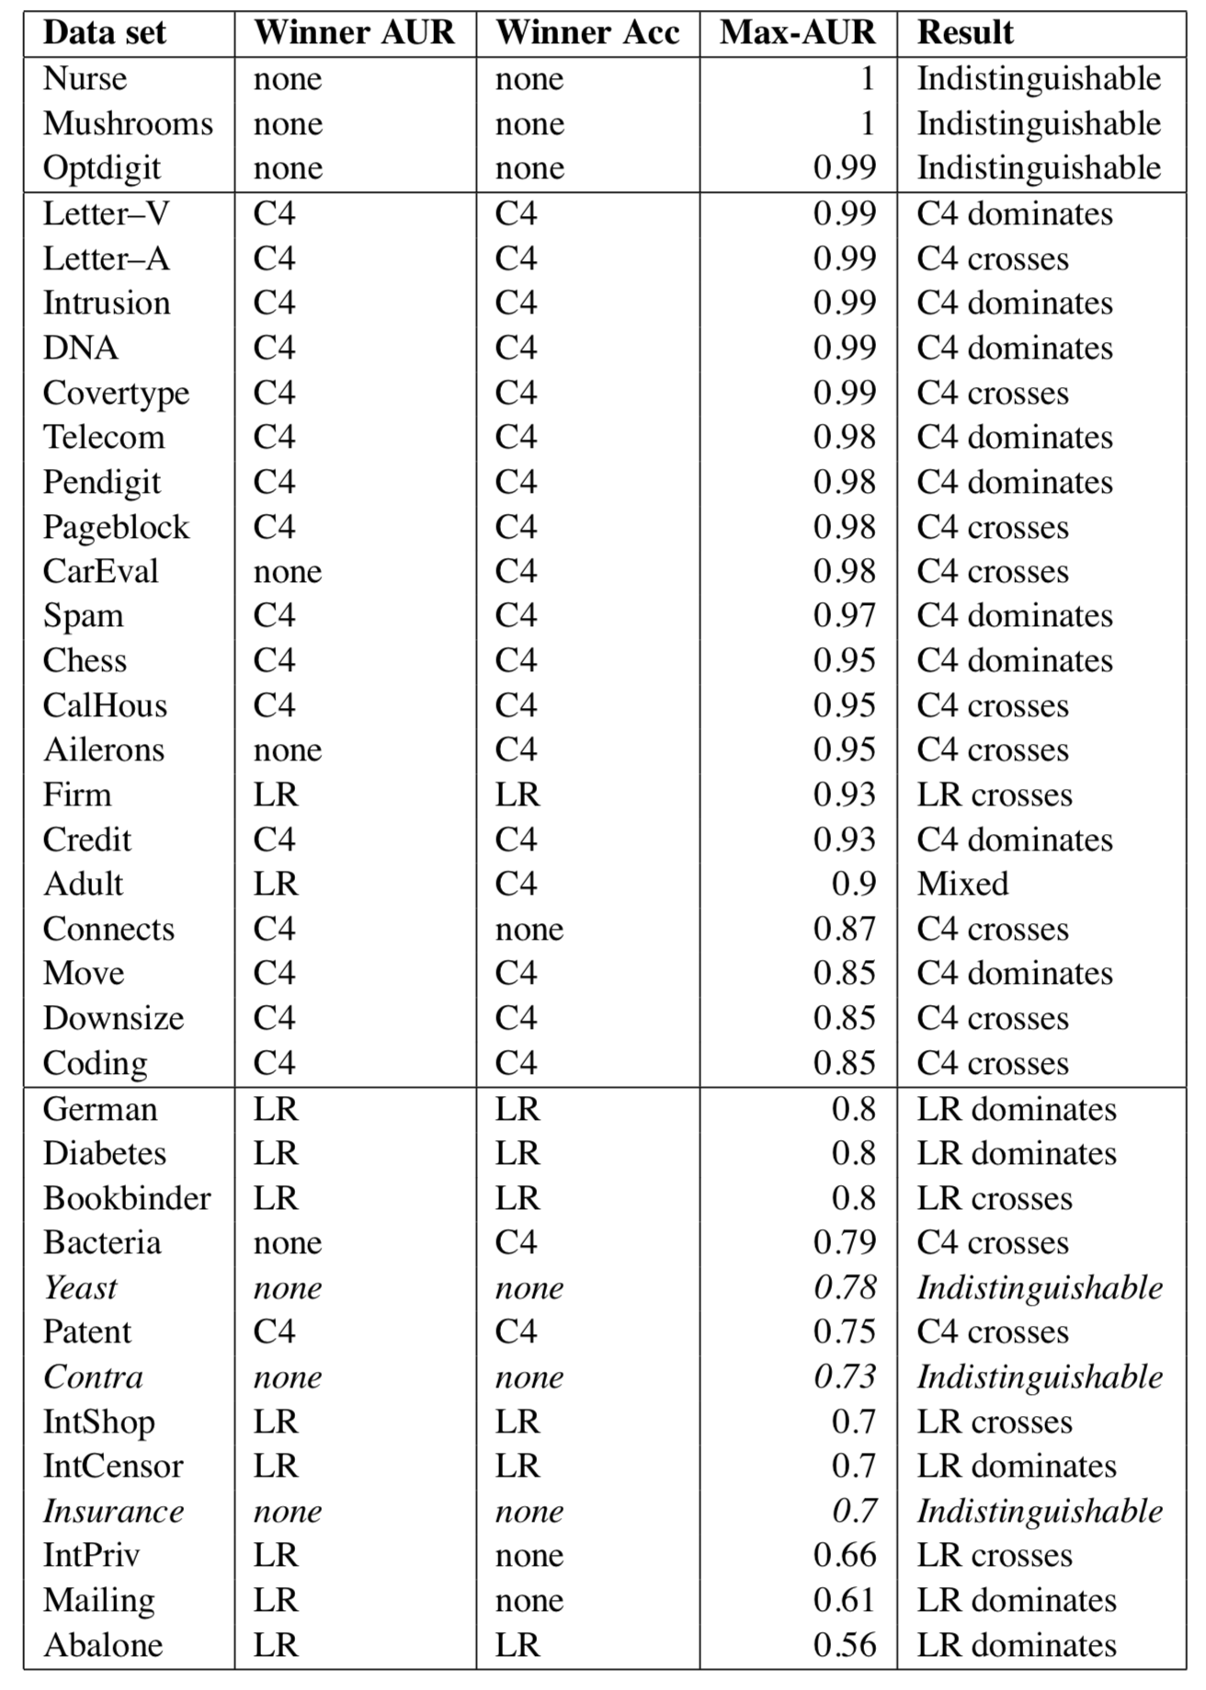
Logistic vs Trees
Deterministic
Decision trees win!
Logistic regression wins!
Random

